Slide 1

BRAIN TUMOR CLASSIFICATION
Batch: 7
GUIDE NAME : Mrs.N.R.S.L.Prasanthi
Batch Members:
A.Sulakshana Sraavya – 22L31A5407
K.Ramya Sri Sai – 22L31A5443
K.Aasa Deepika – 22L31A5442
K.Deepika – 23L35A5412
D.John Wesley – 22L31A5423

Slide 2
INDEX
Abstract
Introduction
Existing System
Proposed System
Methodology
Implementation code
Conclusion

Slide 3
ABSTRACT
Brain Tumours are a significant health concern, requiring early detection for effective treatment. A brain tumor is understood by the scientific community as the growth of abnormal cells in the brain, some of which can lead to cancer. Magnetic Resonance Imaging (MRI) is commonly used for brain tumour diagnosis. In modern days, checking the huge number of MRI (magnetic resonance imaging) images and finding a brain tumor manually by a human is a very tedious and inaccurate task. The brain tumor diagnosis is highly time intensive and largely depends on the radiologist’s skills and knowledge. Classifying types of tumors is also difficult in some cases. Because there are more patients, the amount of data that must be processed has grown significantly. The difficulties are associated with significant brain tumor size, shape, and intensity variations for the same tumor type and similar manifestations of other disease types. It can affect the proper medical treatment of the patient. Traditional machine learning methods often require manual feature engineering, which can be time-consuming and may lack accuracy due to the complexity and variability of tumor characteristics. This project aims to develop a deep learning-based system for automated brain tumour detection and classification of Glioma , Meningioma , Pituitary or heathy brain from MRI images. Deep Learning (DL) approaches have recently been popular in developing automated systems capable of accurately diagnosing or segmenting brain tumors in less time.

Slide 4
INTRODUCTION
The brain is the most complex and complicated part of the human body. Its structure is not easy to understand, as more than one hundred nerves communicate with each other to enable brain function. Brain-related diseases are spreading day by day. Some disorders can be detected at early stages, but some need proper diagnosis, like brain tumours, a type of brain-related disease that may lead to death. So, to overcome this we have introduced “Brain tumor classification” which uses efficientNetB0. In this documentation we provide comprehensive overview of classifying different tumours such as glioma, meningioma ,pituitary and no tumour. To optimize we use EfficientNetB0 model to achieve the highest possible accuracy and efficiency in brain tumor classification.

Slide 5
EXISTING SYSTEM
MRI is one of the most common imaging techniques used to detect brain tumors and classify them. It provides detailed images of the brain's structures, allowing doctors to identify abnormal growth. This model takes MRI scans as a Dataset. Traditional machine learning methods rely on predefined features, which may not capture complex patterns effectively. First the input(MRI scans) is taken and next Data is preprocessed so we can get accurate results i.e., it helps us to resize the image, brightness, change greyscale value etc. since the model can detect 3 types of tumors which is glioma, meninglioma and Pituatary, those datasets are assigned with a particular classes. Data Sets are divided into Training, Testing and validation sets. Building Models like traditional machine learning like KNN, MLP, and SGD can be used but Deep learning model like CNN(Convulational Neural Networks) are preferred more as it can automatically detect important features from provided dataset. To analyze the dataset of MRI Scans. CNN perform Covulational operations, pooling, activation functions etc. Then our model is trained and tested. The accuracy and validation values are calculated. Finally, Depending the values we got, the model is ready to predict the Output.

Slide 6
PROPOSED SYSTEM
In our model, we will use Transfer learning model called “EfficientnetB0”. The reuse of a pre-trained model on a new problem is known as transfer learning. The knowledge of an already trained model is transferred to a different but closely linked problem. Transfer learning can reduce the time taken to train a model and can enhance the performance and increase the accuracy of our model. EfficientNet is one of the most powerful CNN architecture which used for medical-image analysis. EfficientNet is a convolutional neural network that is based on the notion of "compound scaling”.EfficientnetB0 is a baseline model of the family of Efficientnet. EfficientNetB0 is designed to be computationally efficient(i.e computational cost) while still achieving competitive performance. Also it is smaller and has fewer parameters compared to larger models in EfficientNet family. To achieve this, we use Imagenet along with that in our model. ImageNet is a large database or dataset of Images. It was designed to advance deep learning and computer vision field. Imagenet is used to pretrain the EfficientNetb0. The efficientNetB0 architecture is initialized with random weights and pretrained on Imagenet datasets.

Slide 7
METHODOLOGY
To classify brain tumors using EfficientNet-B0, start by collecting a labeled dataset of brain MRI images, resizing them to 150 pixels to match the input size of the model. Preprocess the Data Set. Split the data into training, validation, and testing sets. Then, initialize the EfficientNet-B0 model, pretrained on ImageNet, on the brain tumor dataset by replacing the final classification layer with one that matches the number of tumor classes. Train the model using appropriate hyperparameters such as learning rate and batch size, and validate its performance on the validation set. Finally, evaluate the model on the testing set to assess its accuracy and robustness in classifying different types of brain tumors.

Slide 8
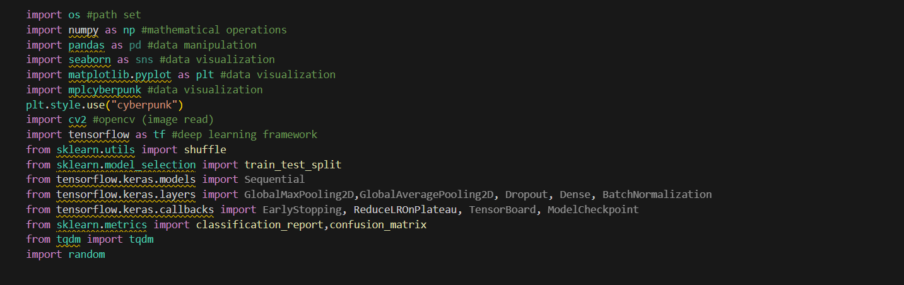
IMPLEMENTATION

Slide 9
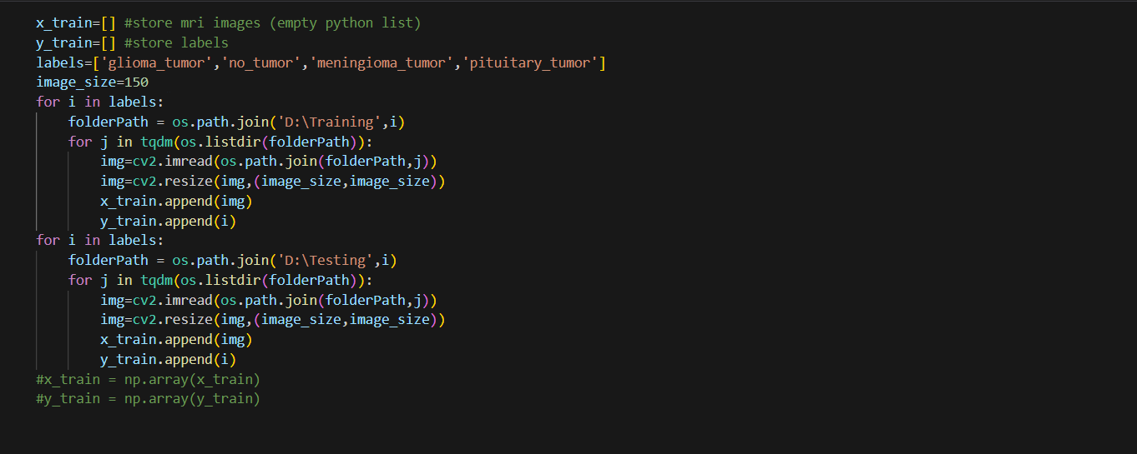

Slide 11
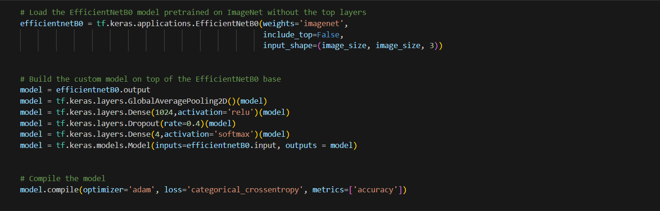

Slide 12
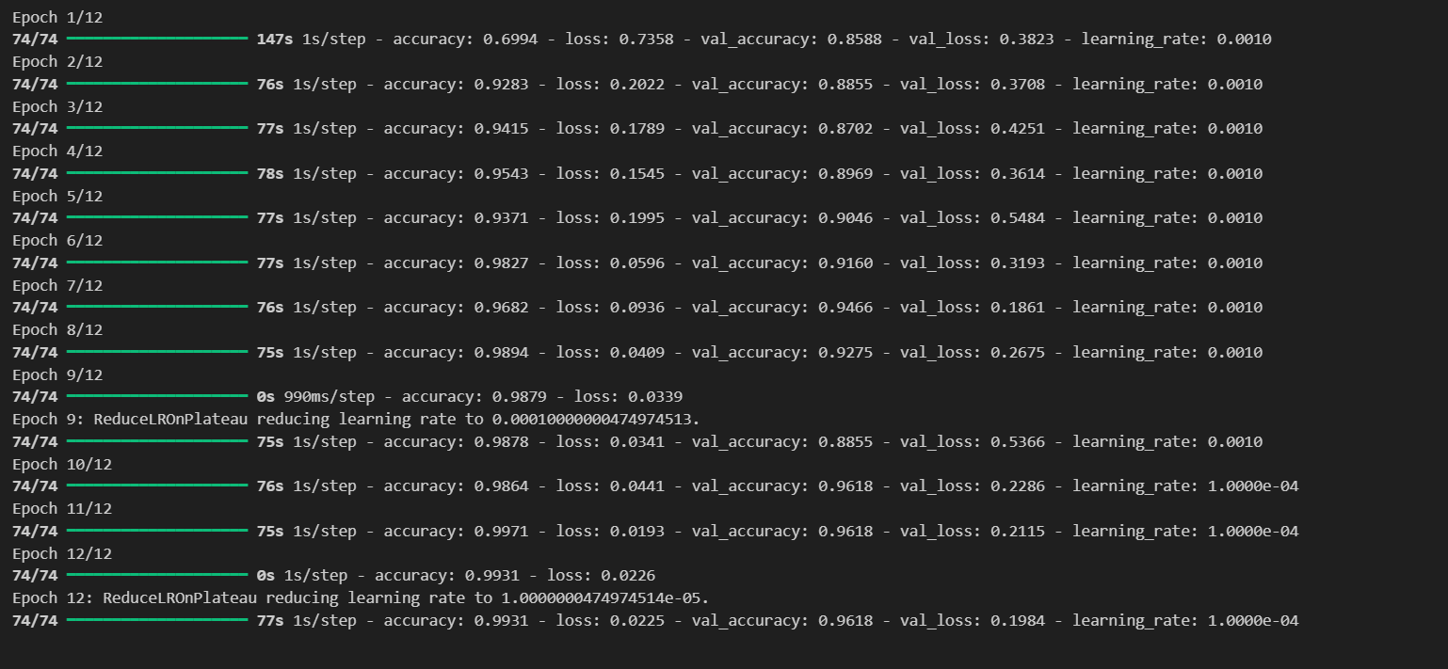

Slide 13
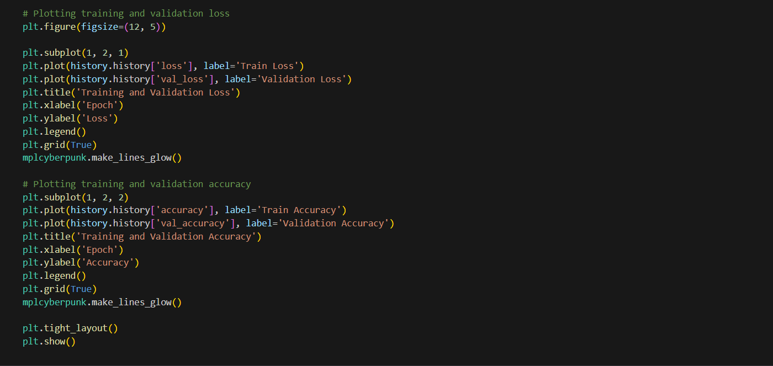

Slide 14
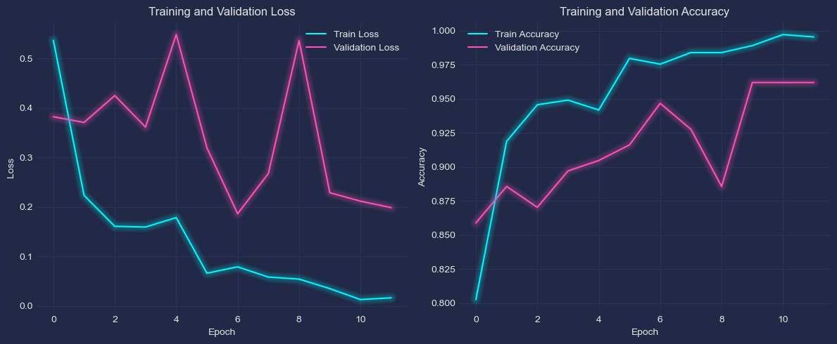

Slide 15
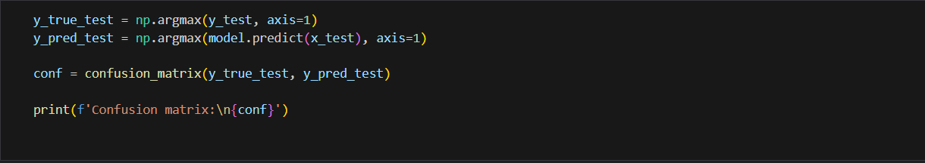
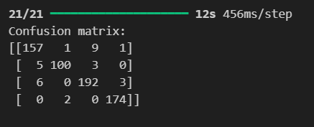

Slide 16
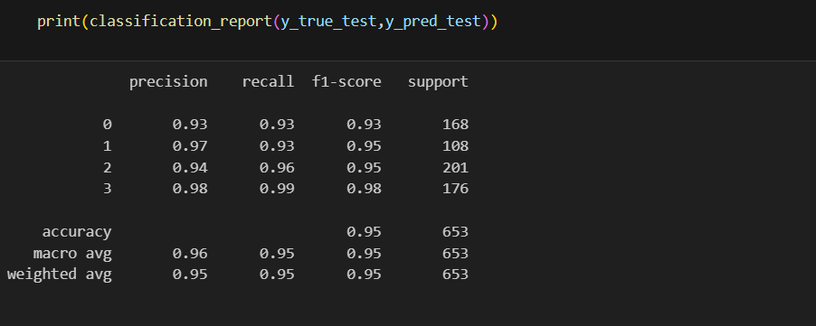
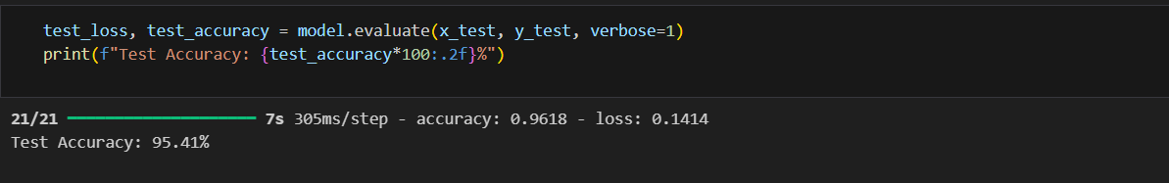

Slide 17
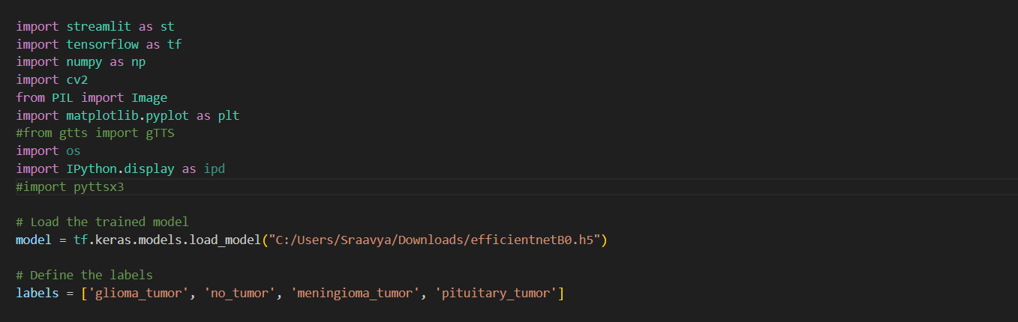

Slide 18
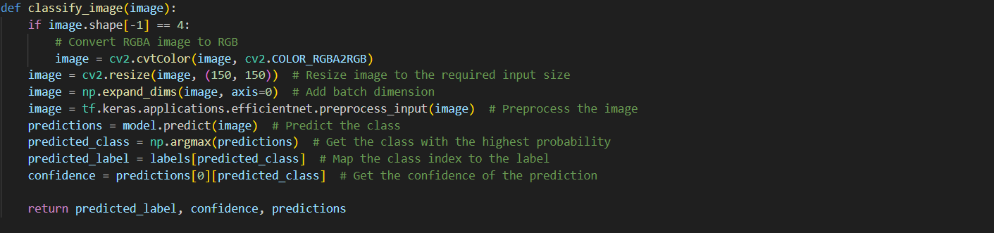

Slide 19
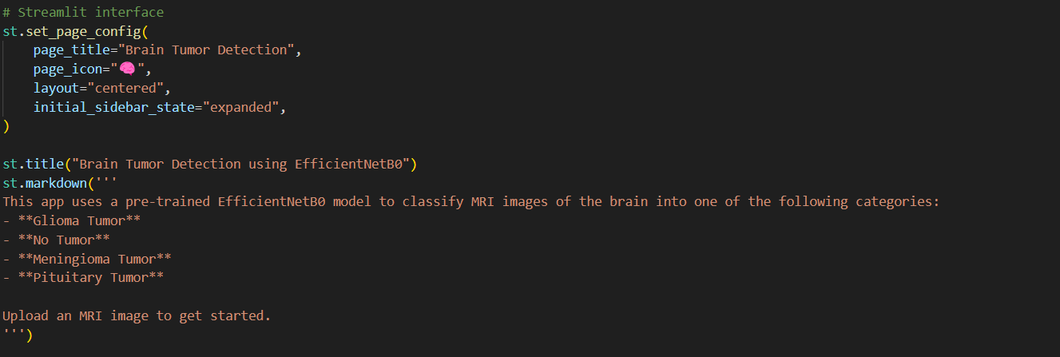

Slide 20
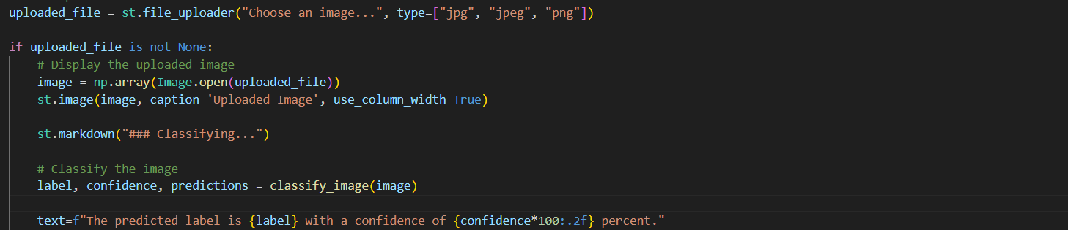
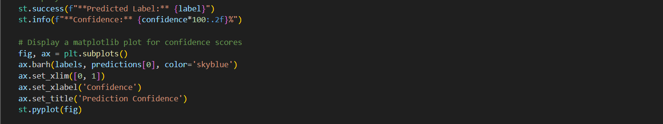

Slide 21
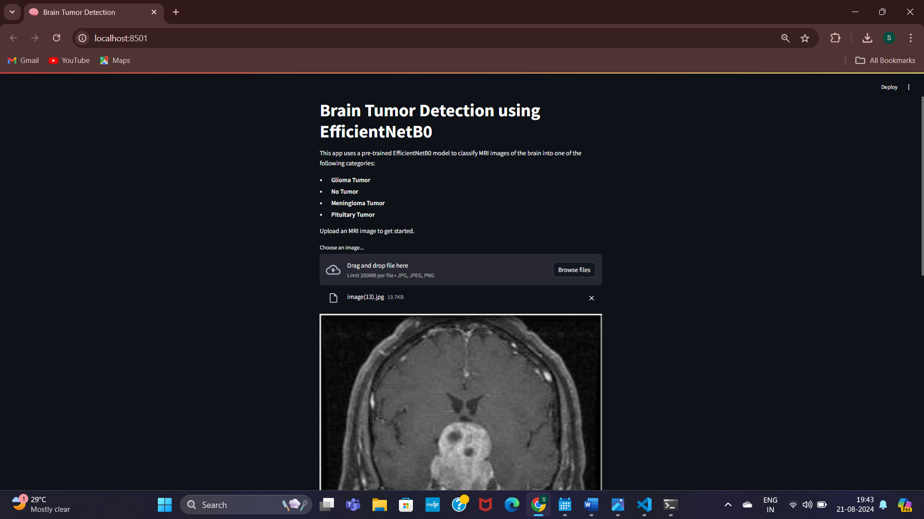
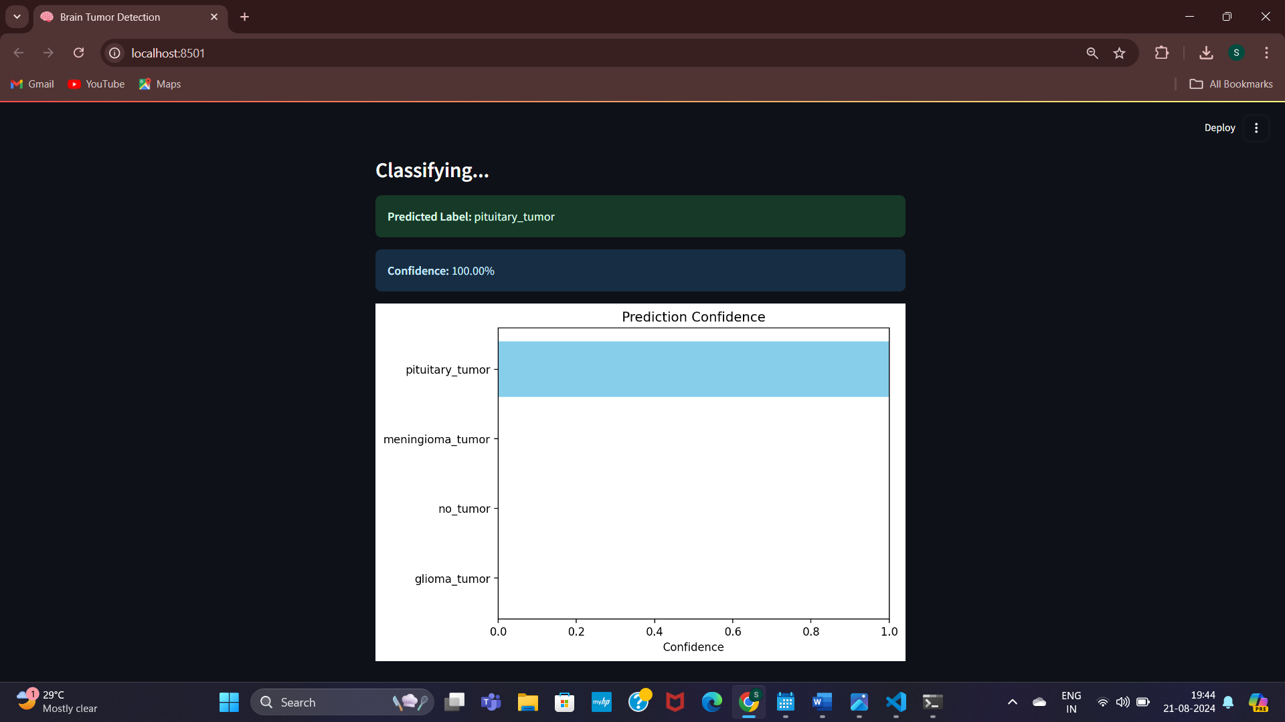

Slide 22
CONCLUSION
Deep learning plays a vital role in medical field. Brain tumor detection model can detect and classify tumor using MRI brain scans. It plays an important role by improving healthcare outcomes. By detecting brain tumors early and accurately, healthcare providers can provide timely and effective care to patients, ultimately leading to better outcomes. Our model focuses on improving the performance of already existing models using transfer learning that is EfficinetNetB0 architecture along with ImageNet. This reduces the computational cost, training time and increases the accuracy of our model.

Slide 23
THANK YOU

